Slide 1
Tillsynsforum April 2021
How we use Data and Insight at the Care Quality Commission
Lisa Annaly, Head of Provider Analytics (Hospitals), Digital and Intelligence Directorate

Slide 2
Outline
About CQC
Background to how we use data and insight has changed over time
Examples of our current approaches to analysis
New developments: in data and digital to support our next strategy
Questions and discussion

Slide 3
Outline
About CQC
Background to how we use data and insight has changed over time
Examples of our current approaches to analysis
New developments: in data and digital to support our next strategy
Questions and discussion

Slide 4
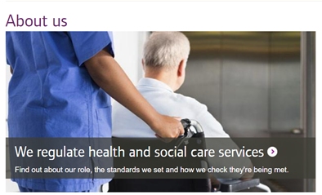

Our role and purpose
The Care Quality Commission is the independent regulator of health and adult social care in England
We make sure health and social care services provide people with safe, effective, compassionate, high-quality care and we encourage care services to improve
We register, monitor, inspect and rate health and adult social care services
We take action to protect people who use services (enforcement)
We speak with our independent voice, publishing our views on major quality issues in health and social care (State of Care, COVID-19 Insight)
We are a national organisation, with offices and colleagues based across England
https://www.cqc.org.uk/what-we-do/services-we-regulate/services-we-regulate

Slide 5
Framework for our Assessment of quality
We ask 5 questions of all care services
Are they Safe? | Safe: you are protected from abuse and avoidable harm.
Are they Effective? | Effective: your care, treatment and support achieves good outcomes, helps you to maintain quality of life and is based on the best available evidence.
Are they Caring? | Caring: staff involve and treat you with compassion, kindness, dignity and respect.
Are they responsive to people’s needs? | Responsive: services are organised so that they meet your needs.
Are they well led? | Well-led: the leadership, management and governance of the organisation make sure it's providing high-quality care that's based around your individual needs, that it encourages learning and innovation, and that it promotes an open and fair culture.
Notes:
Each of our five key questions is broken down into a further set of questions. We call these our key lines of enquiry. When we carry out inspections, we use these to help us decide what we need to focus on. For example, the inspection team might look at how risks are identified and managed to help them understand whether a service is safe. We use different key lines of enquiry in different sectors.
Using key lines of enquiry helps us make sure we're consistent in what we look at under each of the five key questions and that we focus on the areas that matter most.

Slide 6
Outline
About CQC
Background to how we use data and insight has changed over time
Examples of our current approaches to analysis
New developments: in data and digital to support our next strategy
Questions and discussion

Slide 7
CQC’s approach to use of data and analysis – timeline
2009-2013: compliance monitoring
2013-2016: ratings and comprehensive inspections
2016 – 2021:targeted, responsive and collaborative approach
CQC Insight profile for each provider to support monitoring of quality
Intelligent monitoring: a risk stratification of providers – using smaller set of indicators. Published.
Quality and Risk Profile
Risk scores developed for 16 essential standards for all locations (big or small)
Monitoring of clinical outliers for NHS Trusts (mortality and maternity)
Embedded data and analysis in assessments – and inspection reports
2021- new strategy in development
Started to develop future digital plans to enable CQC’s approach to regulation
Data science programme developed
Power BI suite of analytical products with improved accessibility, visualisations of analysis
Proof of concepts developing digital capability and data science techniques
Analysis to identify risk and
Area level analysis to support systems reviews
Focus on data sets available nationally (not directly from providers)
Collection of data from providers to support view of quality
Qualitative analysis development
Notes:
We’ve been developing and using data and analysis within our work over the last 12 years
We’ve had 3 main iterations of our provider tools, but we have some consistent needs for:
Quality indicators that cover the five Key Questions we assess: safety, effectiveness, caring, responsive and well led and that support our role (register, monitor, inspect and rate, enforce and independent voice)
Data and analysis that tells us about quality in a specific service, at a particular location as well as provider level (Trust)
Indicators that focus on poor quality of care so that we can ensure our follow up activities are focused where the risk is highest
Indicators that tell us whether services are improving
Access to timely data sets so that we can reduce/stop the direct information requests we ask of services and reflect the latest picture of quality in our assessments
And:
(since 2013) indicators that tell us about good and outstanding care
Increasing need and use for indicators at system, local and area level

Slide 8

CQC’s Approach to use of data and analysis – continuity
Always in
An evolving set of quality indicators that remain relevant to improvements and advances in care
Analysis that helps us prioritise – focus on services most likely to be providing poor quality of care
Analysis that tell us whether services are improving
Need for timely and nationally available data sets to reflect the latest picture of quality in our assessments, and to reduce the burden of data submission
A “one stop shop” single profile for inspectors
Improving information from people’s experiences of services

Slide 9

CQC’s Approach to use of data and analysis –changes
Some style changes
Using analysis to measure good and outstanding care
Focused analysis on the system – local and area, and pathways of care across organisations
Publication of risk analysis – commitment to transparency is constant - but less easy to do this
New data science techniques for automation and assisting individual decision making

Slide 10
Outline
About CQC
Background to how we use data and insight has changed over time
Some examples of our current approaches to analysis
New developments: in data and digital to support our next strategy
Questions and discussion

Slide 11
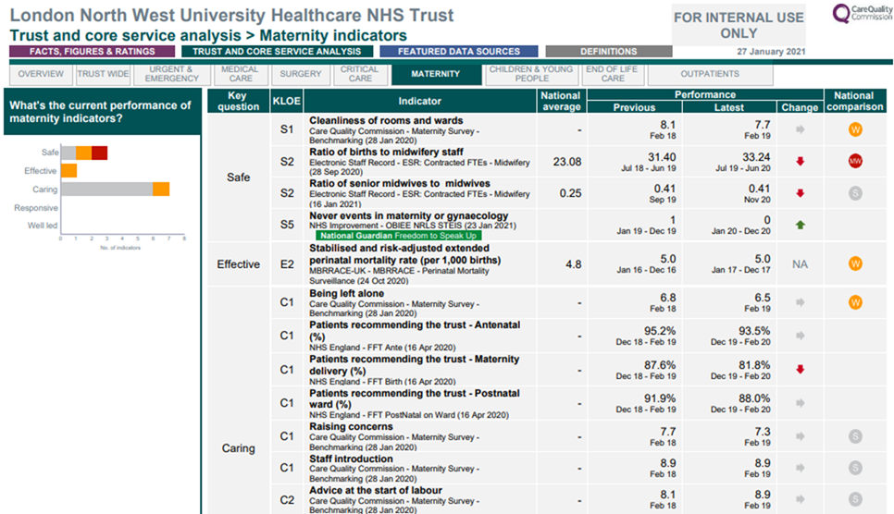
Provider level analysis - CQC INSIGHT

Slide 12
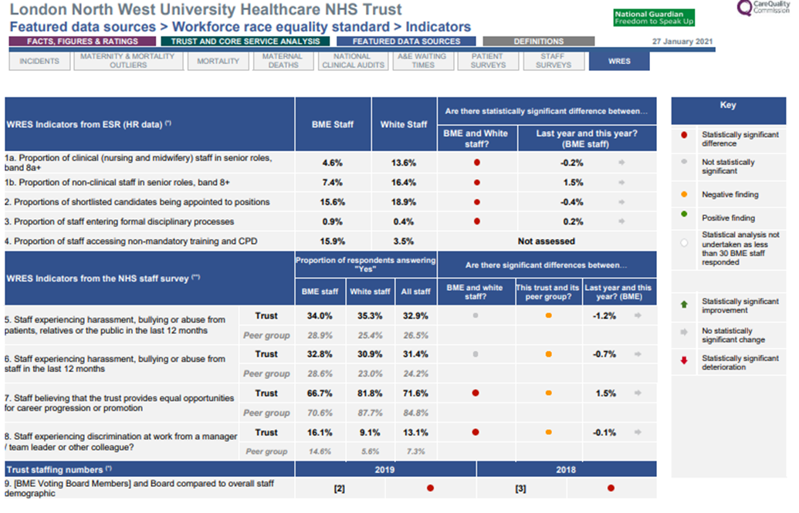
Provider level analysis - CQC INSIGHT

Slide 13
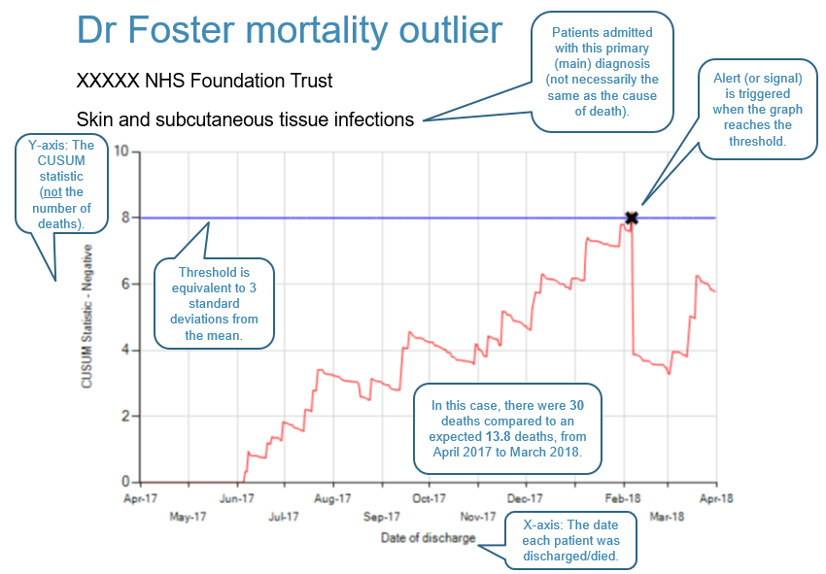
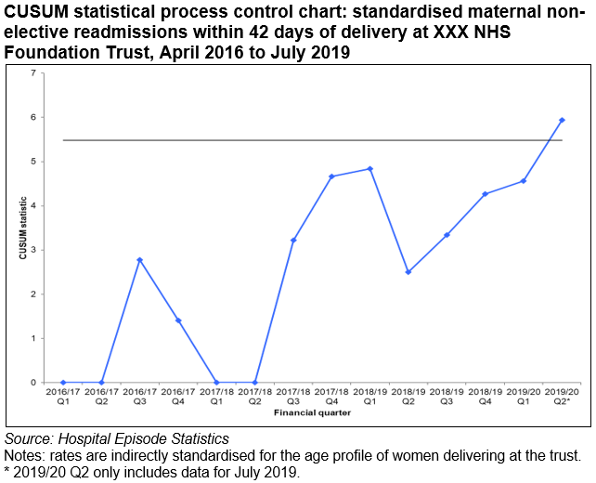
Provider level analysis - Clinical Outliers
Three areas – mortality, maternity and clinical audits
Focus on changes over time
Internal panels – with clinical advisors – followed by engagement with trusts
Mortality and audit processes on pause during the pandemic

Slide 14
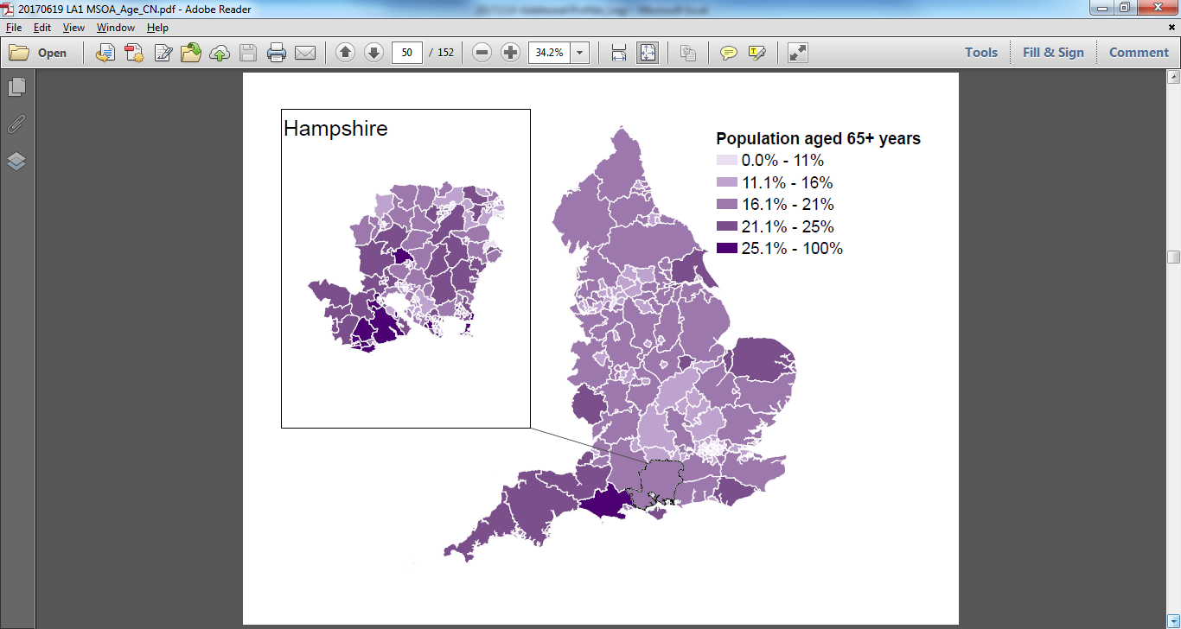
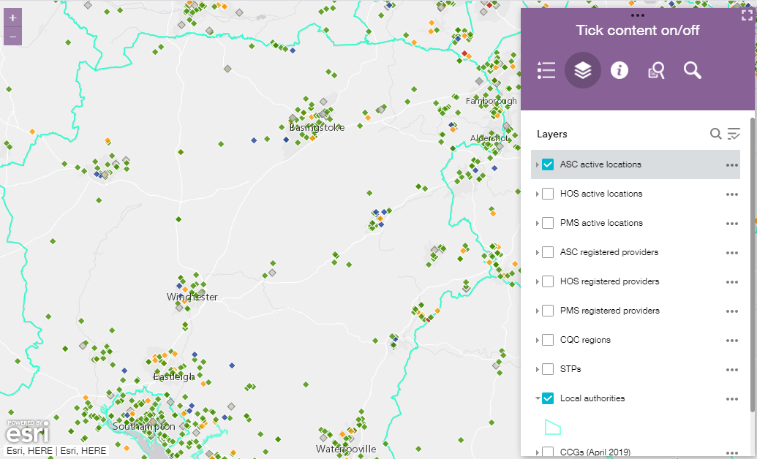
Integration and Systems
Unlike specific providers and services specific measures and data collections for systems are still in their infancy. At CQC we standardly look at data for areas and systems through four different aspects:
Population Characteristics
Quality of Individual Providers
Care Pathways
People Perspectives
Structured interviews and discussions
Understanding local context and how the system is experienced by people who use it, staff and system leaders
Notes:
While different health & social care services have always needed to work together and the experiences of people have always involved multiple types of services/sectors the drive around more structured systems is relatively recent and consequently has little in the way of standard measures and data sets in comparison to those for specific services. Systems are also complex with many different facets making it harder to form an overall picture of quality.
When looking at system quality it can be helpful to consider four main aspects:
Population: who uses these services, what are the demographics and disease profiles
Individual providers: what is the quality of each service in the system
Care pathways: how does the system perform when you look at specific pathways of care
People perspectives: what are the experiences of people using the system, how are providers coming together to deliver care, how is the system led and what is it focussing on

Slide 15
Outline
About CQC
Background to how we use data and insight has changed over time
Examples of our current approaches to analysis
New developments: in data and digital to support our next strategy
Questions and discussion

Slide 16
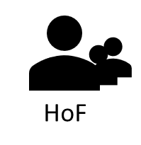

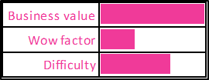


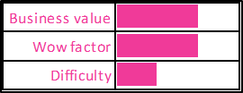

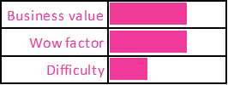

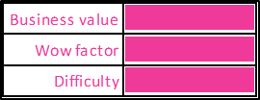
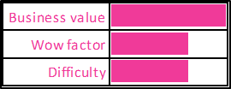


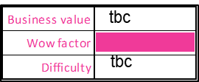
Programme to transform our capability and use of analytics – some work we are exploring
Users
Assessment
Live Dashboard of Health and
Care systems
Comparing maternity services
in an area to inform choice
Comparing care home services
in an area to inform choice
Event-driven insight for Inspectors
Access to intelligence at the
KLOE level
Social Listening

Slide 17
Data Science: Topic Modelling
Problem: every year we receive tens of thousands of free text responses from people giving us their feedback on care. Each one is a piece of valuable data giving us information on a person’s experience.
But each is unique, written by an individual and therefore without reading each one it has been difficult to extract meaning.
Solution: topic modelling a machine learning process that discovers the ‘topics’ or themes in a collection of free text documents.
We have developed algorithms that can look at all of these free text responses and identity the key topics.
Uses: Last year we used it to develop content for our State of Care report, identifying topics that were prevalent in Give Feedback on Care data.
Future: This technique is something we can apply to other high volume text data to look at the big picture. It can help us see trends and understand public sentiment or provider needs or even the most common reasons that people contact CQC’s contact centre.

Slide 18
Event Driven Insight - in development
Aim: to process, in an intelligent way, the data we receive to build a picture of what might be happening in a particular health or care setting relating to a particular issue
Progress: We can train computer software to read information received and recognise key words to enable the notification to be flagged; for instance, a notification about staffing issues could have any of a range of words in it.
By training the software, every new piece of information that contains enough of the words related to staffing would be flagged accordingly.
Once our computer processing can accurately ‘understand’ the text information, it can look at the bigger picture by using analytics to look at all of the data associated with a single setting and piece together any connections (for example indications that this is a persistent problem not an isolated incident).

Slide 19
Outline
About CQC
Background to how we use data and insight has changed over time
Examples of our current approaches to analysis
New developments: in data and digital to support our next strategy
Questions and discussion

Slide 20

Discussion and thank you
Some questions to think about
What do you think are the common areas between CQC’s approach and yours?
What is different?
Is there any learning you could take from what CQC is doing?
Is there anything you’d like to hear more about for a separate session?

